Slide 1
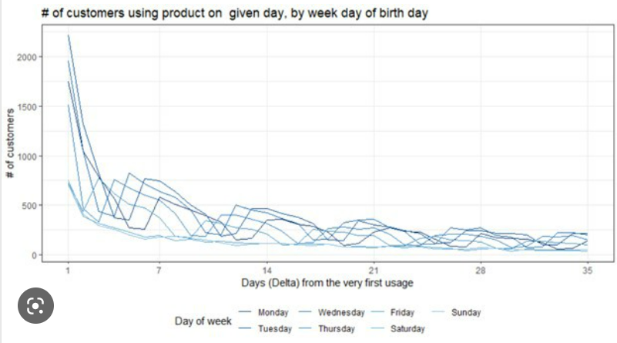
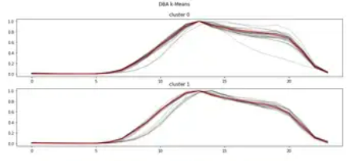
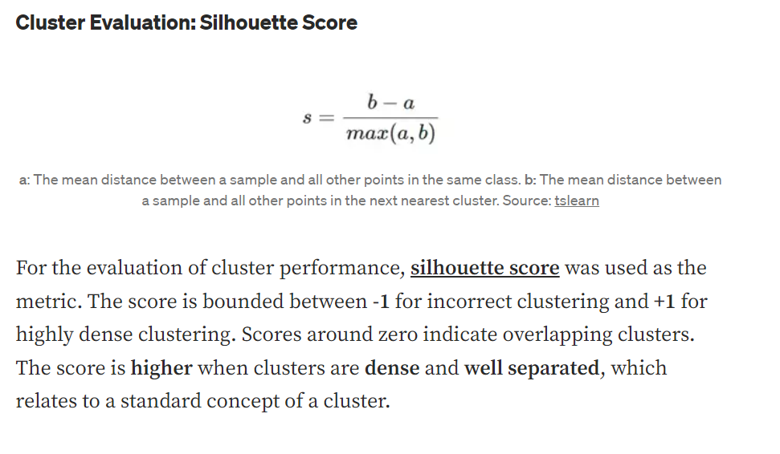
Time Series Clustering
Time Series forecasting
Clustering by area
Inferential statistics
Time Series Clustering of Electricity consumption
Overall trend of household consumption
Select cluster techniques
Temporal Clustering
Spatial Clustering
Cluster score : 0.268
A Silhouette score to show how well the cluster separate. Scores around zero indicate overlapping clusters. The score is higher when clusters are dense and well separated.
Graph of consumption rate according to time (x: Timeline, y: Consumption)
Notes:
https://towardsdatascience.com/time-series-clustering-deriving-trends-and-archetypes-from-sequential-data-bb87783312b4

Slide 2
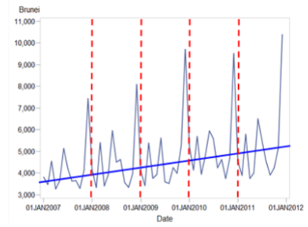
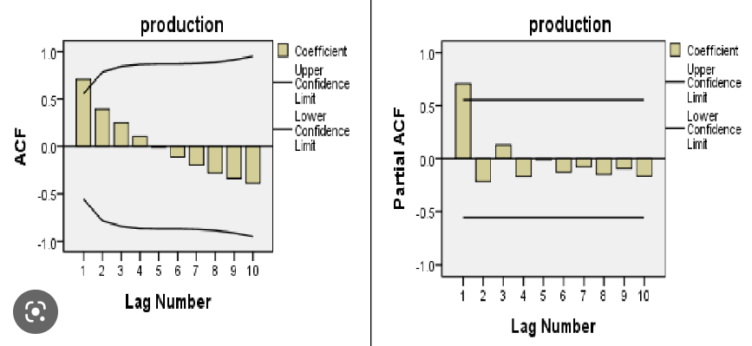
Time Series Clustering
Time Series Forecasting
Clustering by area
Inferential statistics
Time Series Forecasting of Household electricity consumption
ARIMA
AR
I
M
ACF, PACF plots

Slide 3
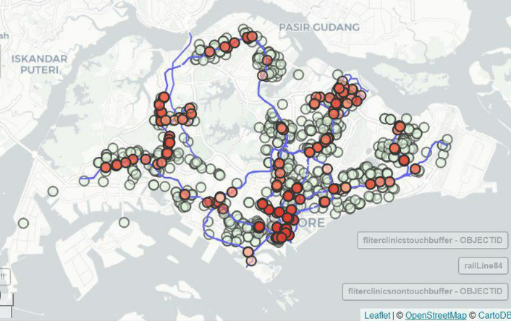
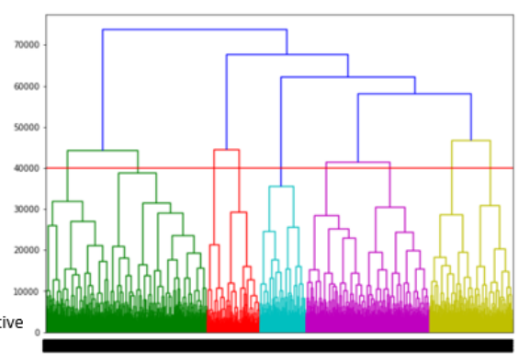
Time Series Clustering
Time Series Forecasting
Clustering by area
Inferential statistics
Cluster of consumption pattern by area
Map color the planning area according to the cluster
Select cluster techniques
K-Mean
Hierachical
LDA
Show parameter tuning pop-up according to the selection
K-Mean Parameter tuning
K =
Distance measurement
Bar that allow user to drag up and down
Drop-down list of measurement techniques

Slide 4
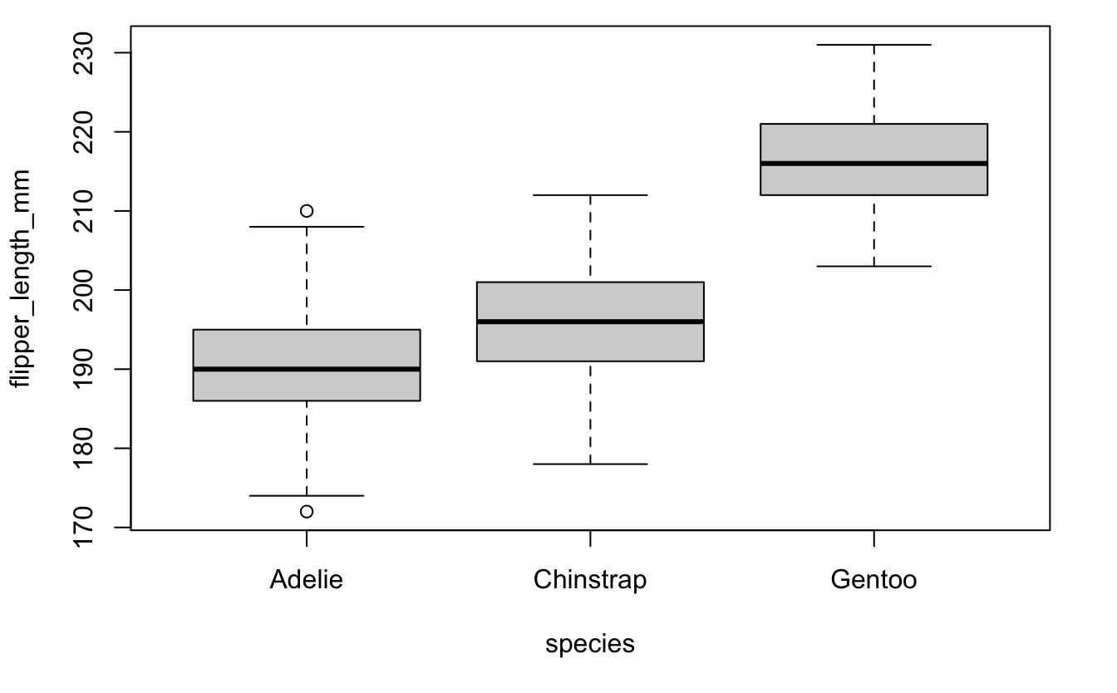
Time Series Clustering
Time Series Forecasting
Clustering by area
Inferential statistics
ANOVA
Select parameter
P-value:
Select dependent variable:
Notes:
https://r.tquant.eu/tquant/Tartu/Frequentist_vs_Bayes_post_hoc/

Slide 5
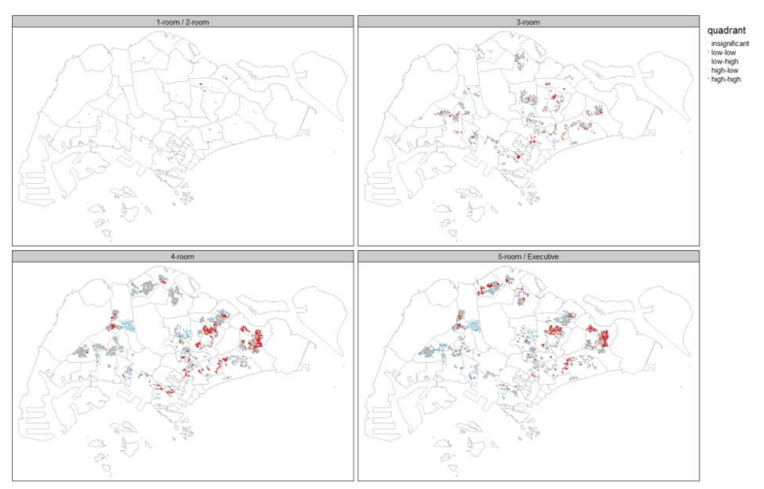
Time Series Clustering
Time Series Forecasting
Clustering by area
Inferential statistics
Notes:
https://r.tquant.eu/tquant/Tartu/Frequentist_vs_Bayes_post_hoc/

Slide 6
1) visualise time series of data consumption, then do time clustering
2) we can also predict electricity demand for planning purpose
3) we can also combine this dataset with population to see how different demographics can affect consumption, then we can better predict maybe?
4) cluster by area and plot in map. user can input cluster technique or #of cluster
5) With the grid emission factor, project what’s the pollution contributed from power generation (could pollution be controlled by electricity prices?)
6) saw manpower data. Study the demographics of employees. Do the electricity market expects a manpower crunch in the near future? Is automation the way to go?
7) some inferential analysis to consider: tariff and consumption correlation, test any significant difference in consumption between different type of dwelling or planning area.
8) time series analysis - stationary, seasonality, ARIMA etc
9) Power balance - simple visualisation/calculation - understanding the power gap and major power consumers based on power balance
10) Inferential analysis e.g. ANOVA on the consumption by area -> Difference in mean of consumption across planning area

Slide 7
Project Timeline
Kick-Off
Meeting, 14 Jan
Prof Consultation
Proposal due,
12 Feb
Final Submission,
2 Apr
Proposal Preparation
Enhanced Prototype
Brainstorming
Prelim Prototype
Data Exploration
Data Prep
Shiny App
Poster
8 Jan 2023
22 Jan 2023
5 Feb 2023
19 Feb 2023
5 Mar 2023
19 Mar 2023
2 Apr 2023

